Slide 1
Global Healthcare Data ETL & Analysis CLI

Slide 2
Contents :
Problem Statement
Project Objective
Technology Stack
Data Sources
Database Schema
ETL Workflow
CLI commands examples
Demo Screenshots
Limitations
Conclusion

Slide 3
Problem statement
Extract COVID-19 case data from a public API.
Extract vaccination data from WHO’s dataset(CSV format).
Clean and transform the data using Python and Pandas.
Load the structured data into a MySQL database.
Enable CLI-based interaction for quering and analyzing data.

Slide 4
Project Objective
Develop a CLI-based ETL system for healthcare data.
Extract COVID-19 and vaccination data from a public API and WHO csv.
Transform data using python (cleaning, formatting and type conversion).
Load structured data into MySQL (daily_cases and vaccination_data tables.)
Enable CLI-based analysis: trends, top-metrics and summary queries.
Build a CLI-based ETL system to extract, clean and store COVID-19 and vaccination data in MySQL.
Enable users to analyze the data via command-line queries and trend reports.

Slide 5
Technology Stack
Languages & Tools Used:
Programming Language: Python
Data Manipulation/Transformation: pandas
Database: MySQL, with the mysql.connector library for connectivity.
CLI Framework: argparse for building the command-line interface.
HTTP Requests: requests library for making API calls.
Configuration Management: configparser for reading settings from a
config.ini file.
Logging: The built-in logging module for application logs and error handling.

Slide 6
Data Sources
COVID-19 Case Data (API Source) :
- Provider : API Ninjas (http://api.api-ninjas.com/v1/covid)
- Fetches country-wise daily cases & deaths.
- Supports fetching data via country name and optional date.
- JSON format.
Vaccination Data :
- WHO Dataset(CSV)
- It contains country-level vaccine administration records.

Slide 7
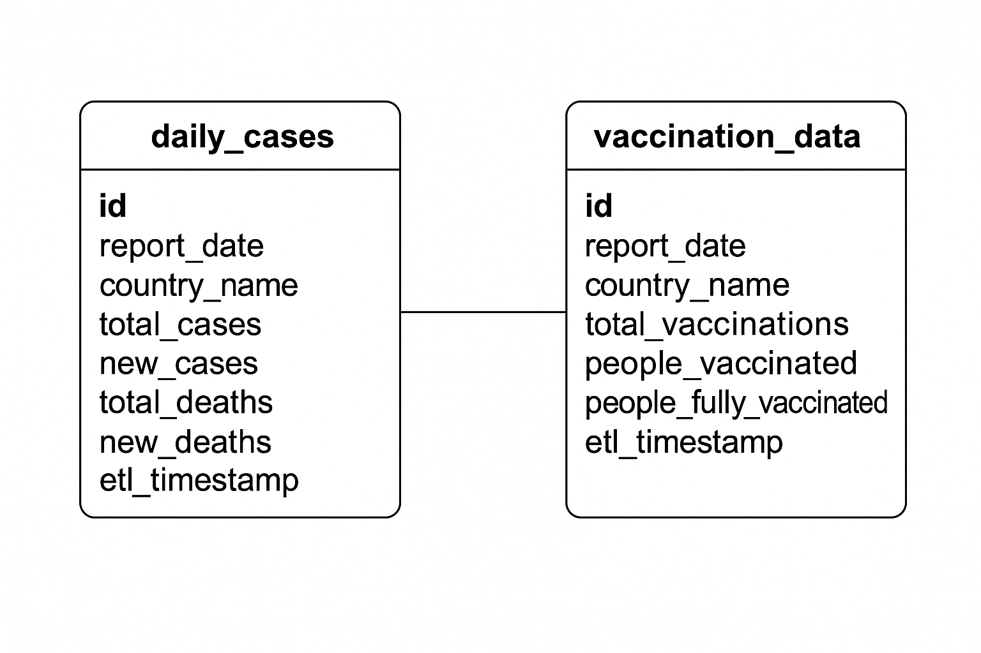
Database schema

Slide 8
ETL Workflow – End-to-End Data Pipeline
1. Extract
- COVID-19 daily case data fetched using API Ninjas REST API.
- Vaccination data read from WHO-provided CSV file.
2. Transform
- Cleaning and removing incomplete data.
- Renaming inconsistent column names.
- Ensuring uniform format and structure.
3. Load
- Connect to the MySQL database.
- Insert transformed data into daily_cases and vaccination_data tables.

Slide 9
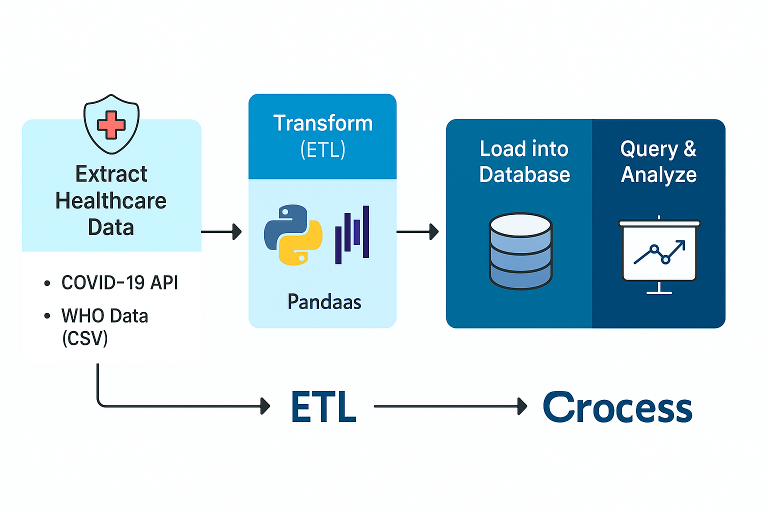
Healthcare data etl workflow

Slide 10
CLI Command Examples
The Command-Line Interface (CLI) allows users to fetch, query, and analyze data directly from the terminal using simple Python commands.
→ # Fetch COVID-19 data for a specific country
python main.py fetch_data –country “India”
→ # Query total reported cases for a specific country
python main.py query_data total_cases “India”
→ # Get daily trend of new cases for a country
python main.py query_data daily_trends India new_cases
→ # Getting top 3 countries by total vaccinations
python main.py query_data top_n_countries_by_metric 3 total_vaccinations

Slide 11
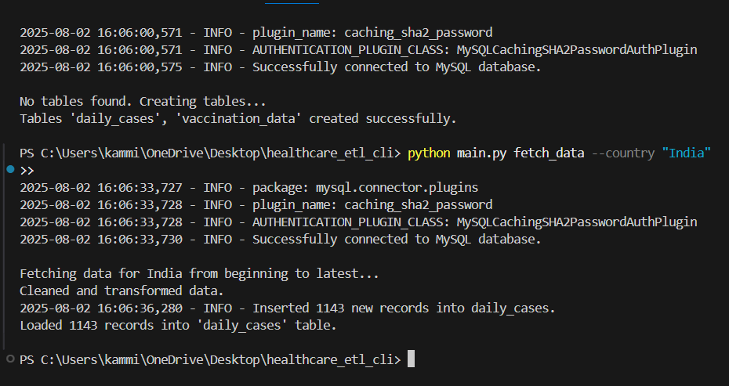
Demo Screenshots
Screenshot 1 : Fetching data from the API.

Slide 12
Known limitations
Limited API Query Parameters :
- The current COVID-19 API only supports queries by country. It does not
natively support date ranges (`start_date`, `end_date`).
Single-Country Fetch per Command :
- Data can be fetched for one country at a time only. Batch fetching or parallel
extraction is not implemented.
No advanced visualizations :
- Output is printed in tabular format only (no charts or graphs).

Slide 13
Conclusion
End-to-end working with CLI-based ETL system.
Covers the entire data lifecycle: extraction, transformation, loading, and querying.
RESTful APIs for real-time COVID-19 data.
CSV ingestion for WHO vaccination records.
Pandas for robust data cleaning and transformation.
MySQL for structured data storage and retrieval.

Slide 14
Thank you

